Slide 1
Visualization with seaborn module 8
Note to other teachers and users of these slides. Feel free to use or modify these slides as you wish. If you use a significant portion of these slides in your own lecture, please include this message, or the following link to the source repository of Michele’s lectures on github:
https://github.com/samorani. Comments and corrections are welcome.

Slide 2
This course
TODAY
Seaborn
scikitlearn
Machine learning package
pandas
Data structures package
numpy
Computation package
Python
Language, syntax

Slide 3
Today’s data set: adult.csv
https://www.kaggle.com/uciml/adult-census-income
This data was extracted from the 1994 Census bureau database by Ronny Kohavi and Barry Becker (Data Mining and Visualization, Silicon Graphics). The prediction task is to determine whether a person makes over $50K a year.

Slide 4
Types of variables
Numeric or continuous: (e.g., age) a variable with many (sometimes infinite) possible numeric values
Categorical or nominal: (e.g., sex, race) a variable with a finite set of values. There is no intrinsic order between them (sexes or races cannot be sorted from smaller to larger)
Ordinal: a variable with a finite set of values that can be sorted. Example in this data set: income (“< 50k”, “>= 50k”)

Slide 5
Discretization
We can turn a numeric variable into an ordinal one through two functions.
For equal-width binning, use pandas.cut. All bins will be of the same width.
For equal-frequency binning, use pandas.qcut. All bins will (attempt to) have the same number of records.

Slide 6
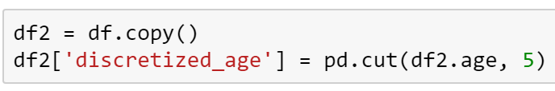
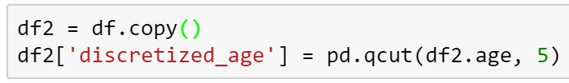
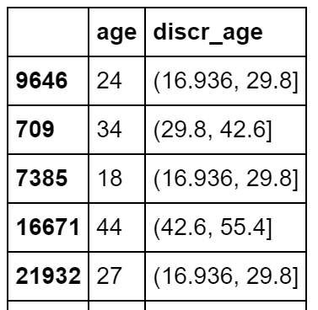
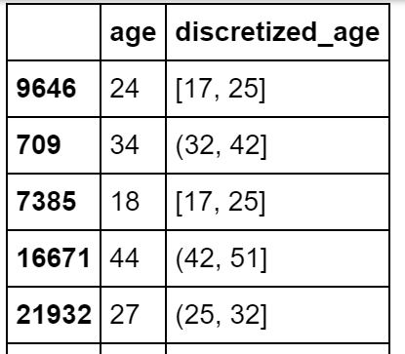
EQUAL-WIDTH BINNING: CUT
EQUAL-FREQUENCY BINNING: QCUT
Number of bins
Series to discretize

Slide 7
Visualization by combination and type of variables

Slide 8
One variable

Slide 9
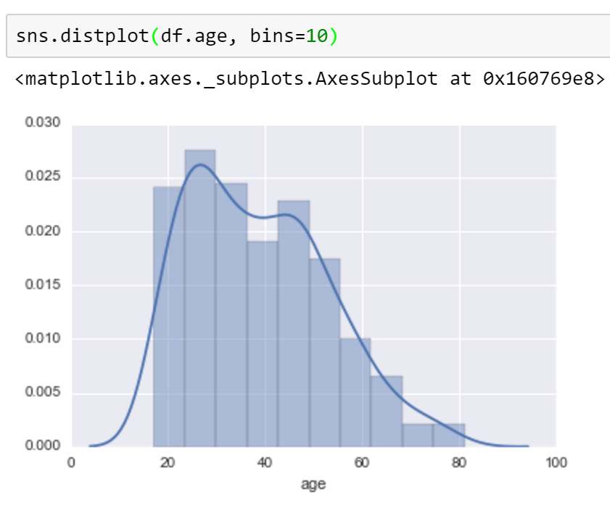
One numeric variable

Slide 10
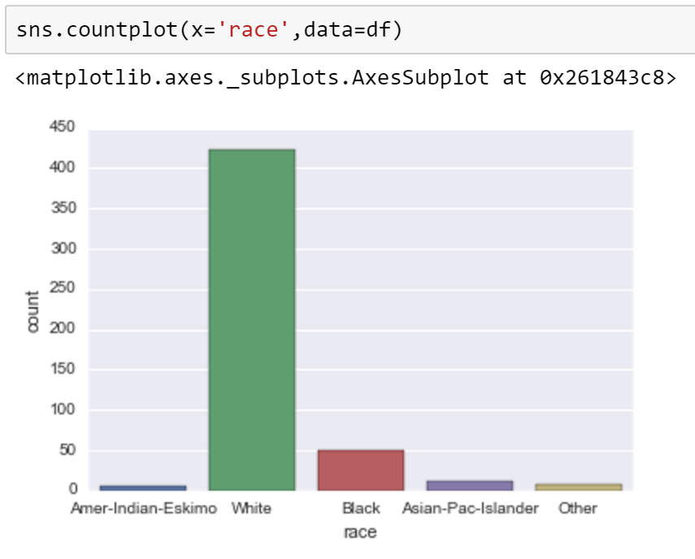
One categorical variable

Slide 11
Two variables

Slide 12
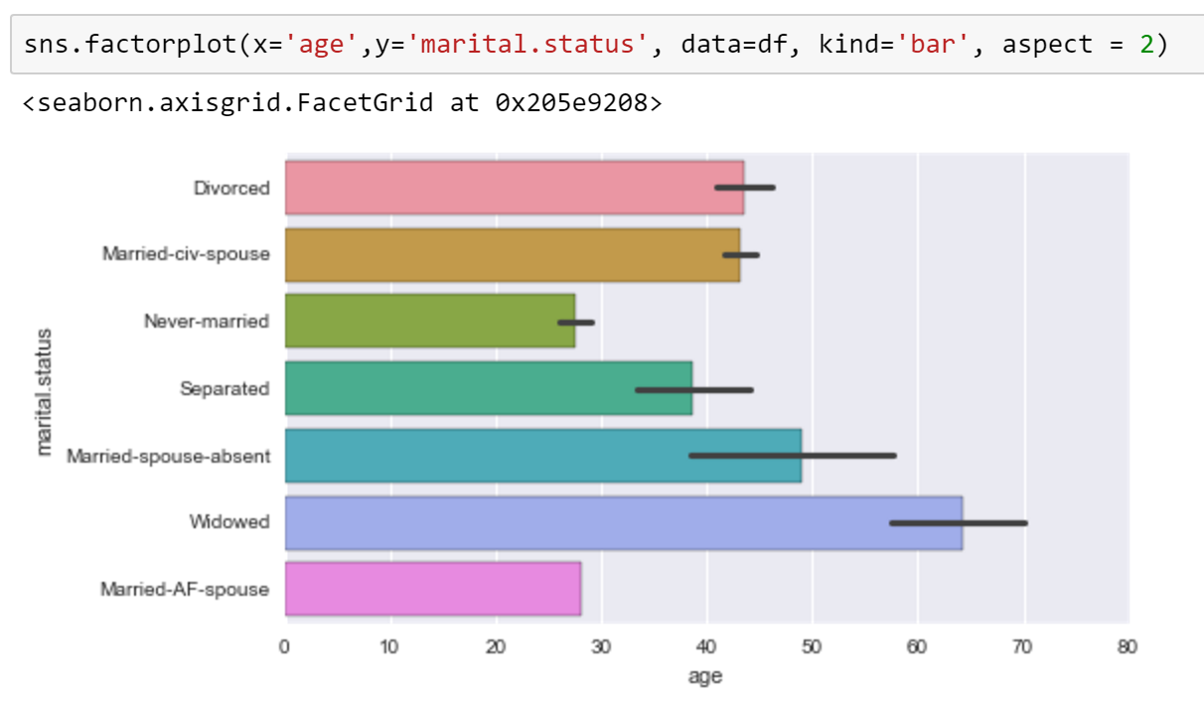
One categorical and one numeric variables
Mean of age grouped by marital.status

Slide 13
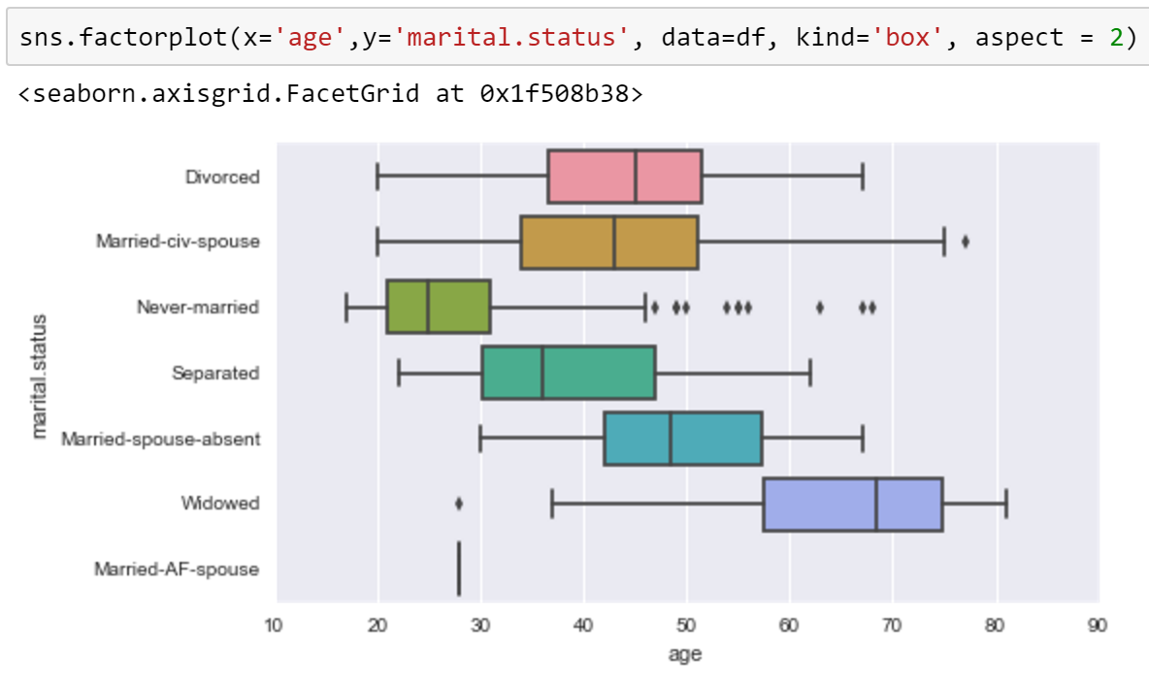
One categorical and one numeric variables
Mean of age grouped by marital.status

Slide 14
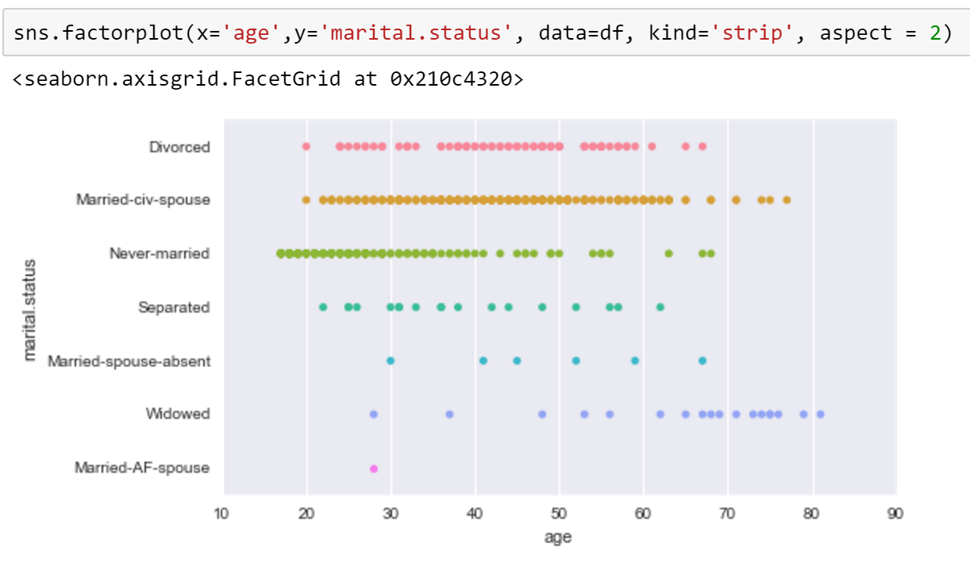
One categorical and one numeric variables
Mean of age grouped by [marital.status]

Slide 15
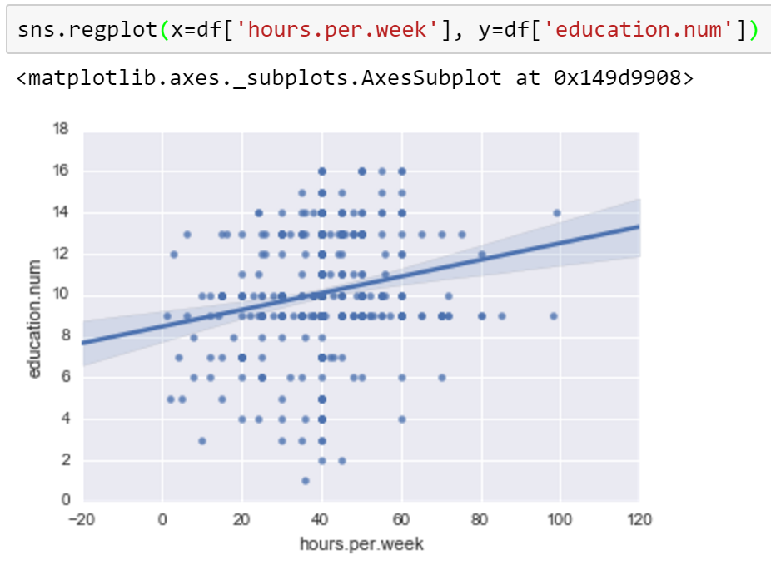
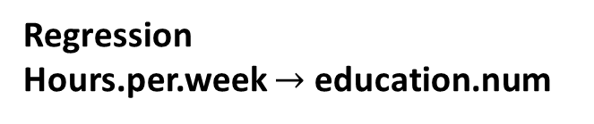
Two numeric variables: Regression
Regression
Hours.per.week $→$ education.num

Slide 16
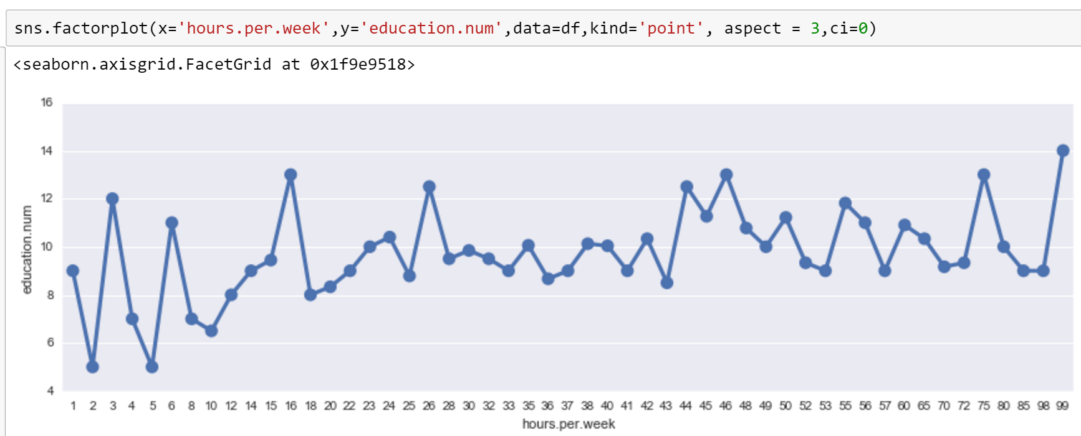
Two numeric variables: line

Slide 17
Three variables

Slide 18
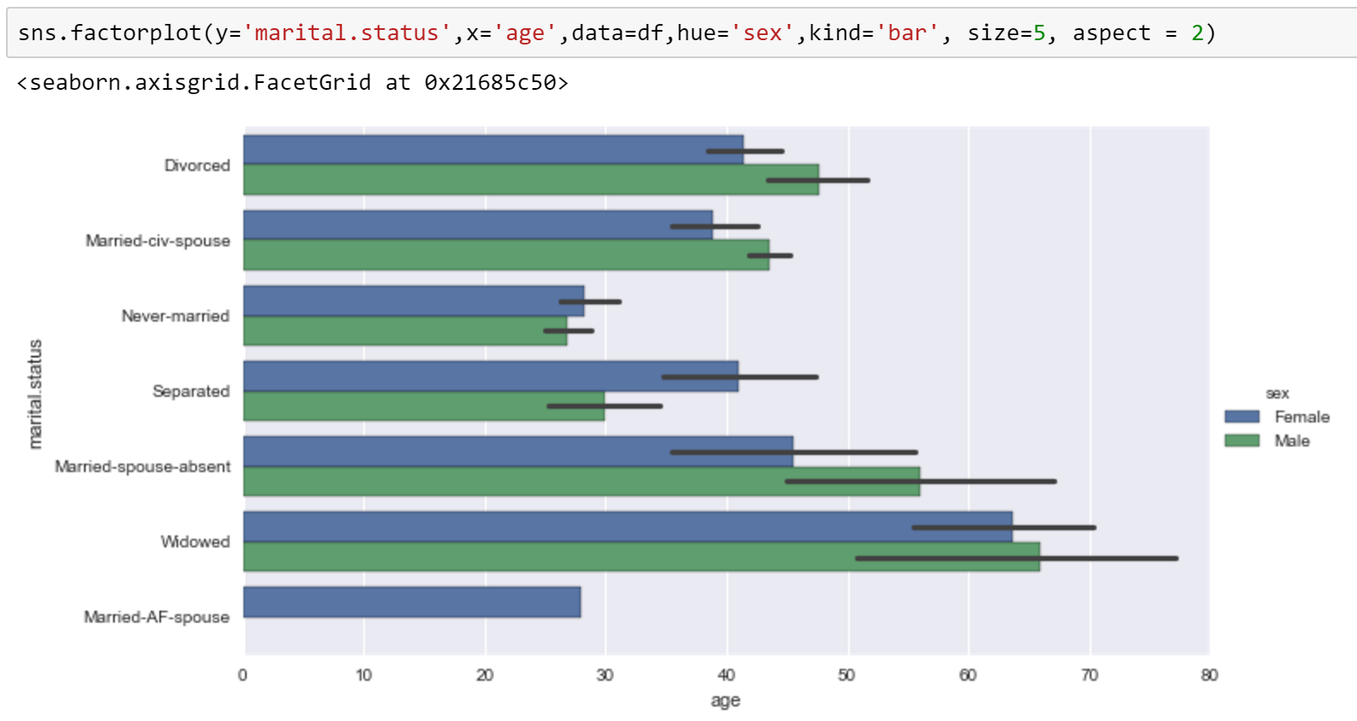
Two categorical and one numeric variables
Mean of age grouped by [marital.status,sex]

Slide 19
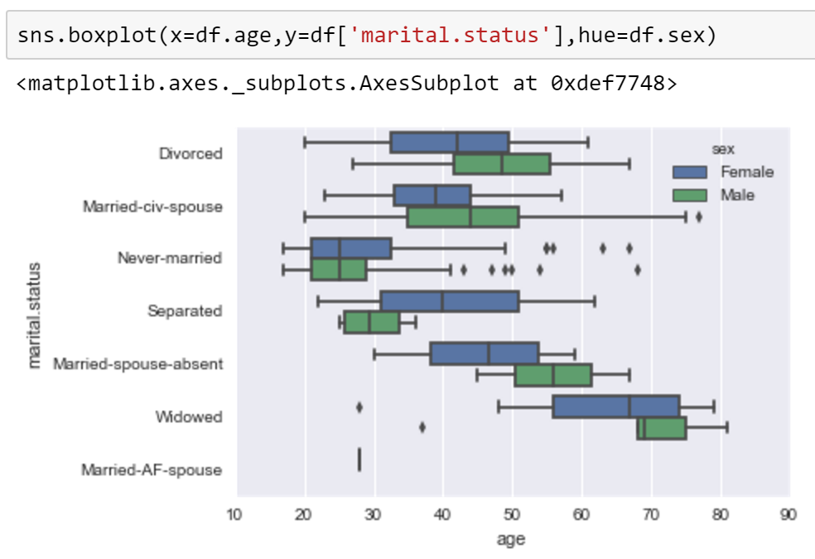
Two categorical and one numeric variables
Mean of age grouped by [marital.status,sex]

Slide 20
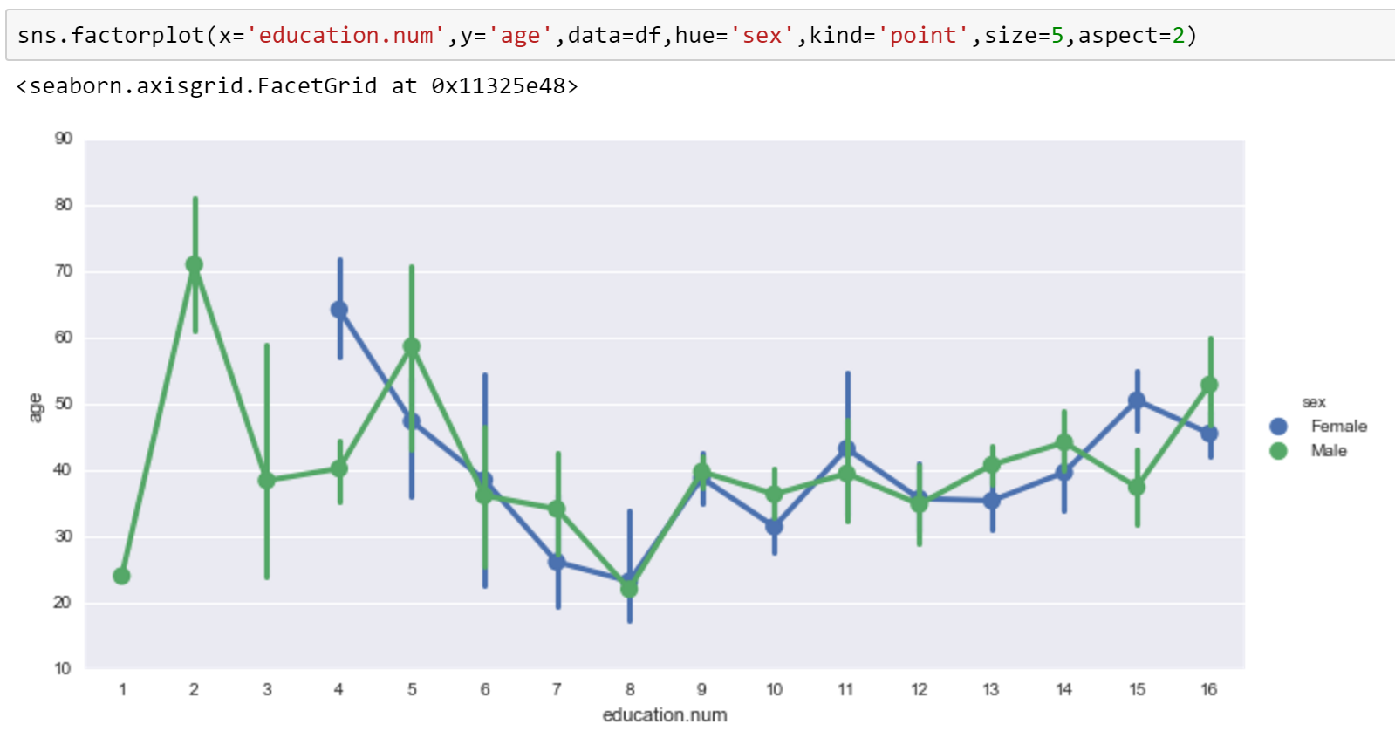
Two numeric and one categorical variables

Slide 21
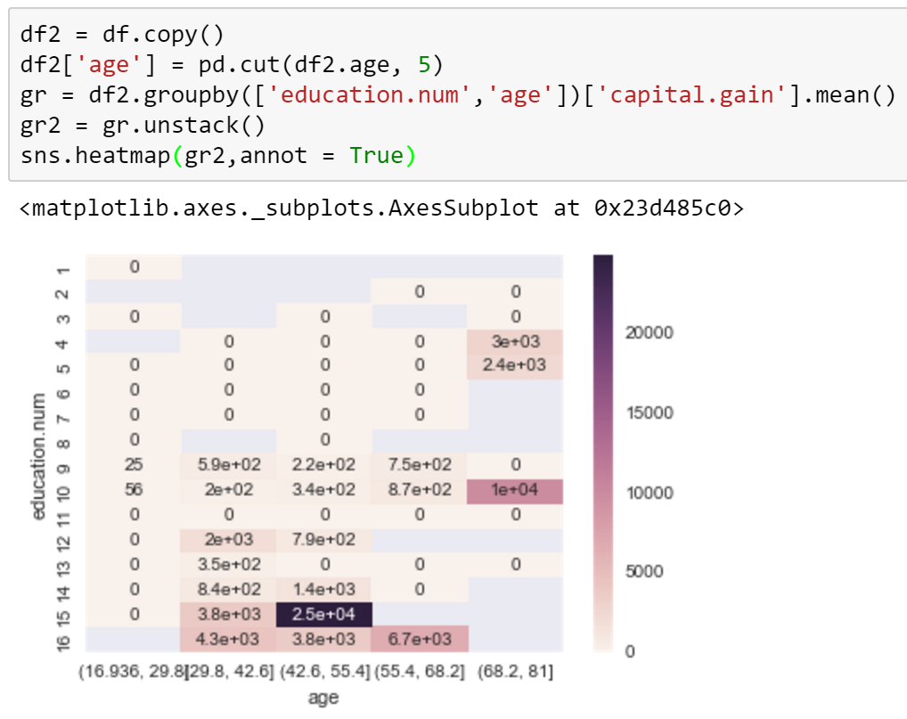
Two ordinal and one numeric variables
Mean of capital.gain grouped by [discretized age,
education.num]

Slide 22
Four variables

Slide 23
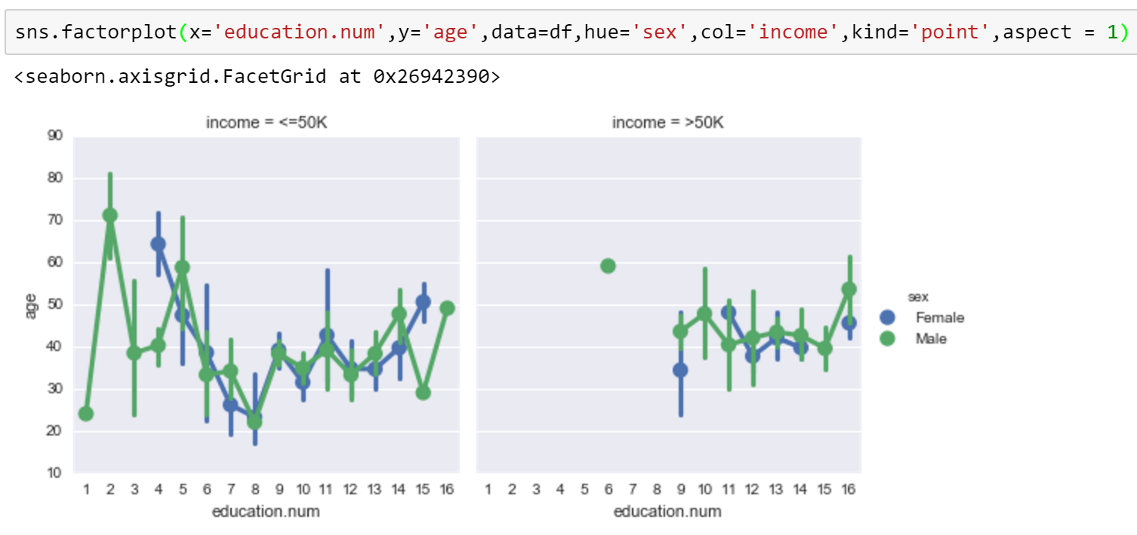
Two categorical and two numeric variables

Slide 24
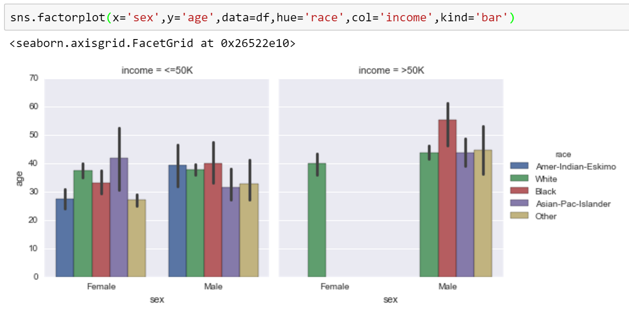
Three categorical and one numeric variables

